Slide 1
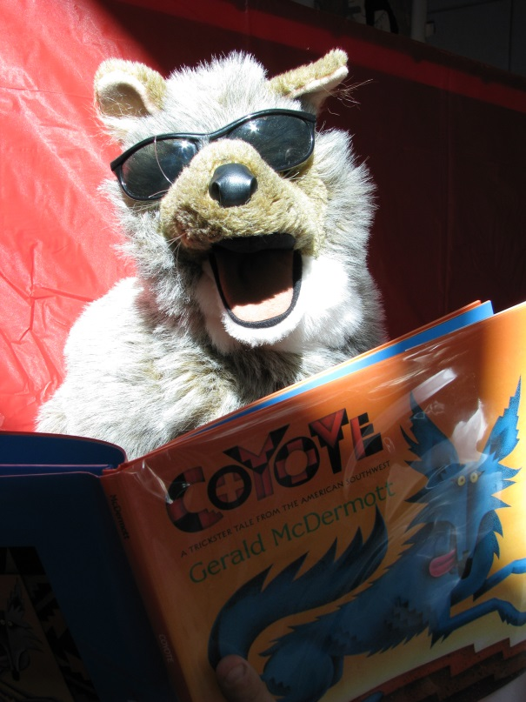
How to Access and Enjoy
the Kay Carl Library’s eBooks & Audiobooks
Book Master Dwyer, revised 3/2017

Slide 2
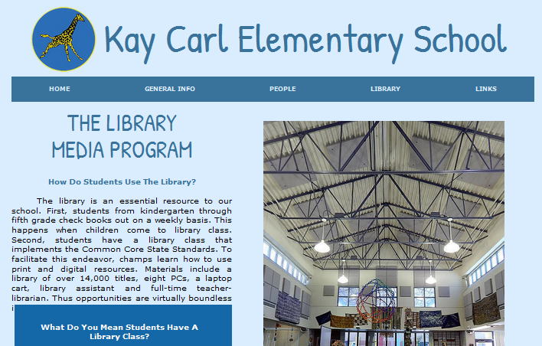
Step 1
Go to Kay Carl’s
Library Media Program Web Page
www.tinyurl.com/libraryatkaycarl

Slide 3
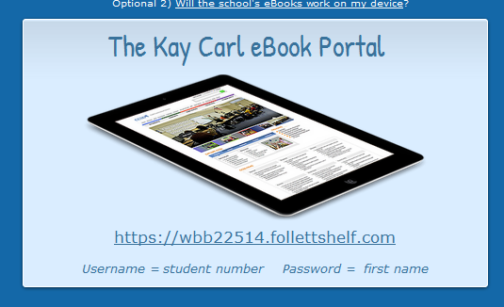
Step 2
Scroll down to the eBook Portal and click the Destiny Discover link.

Slide 4
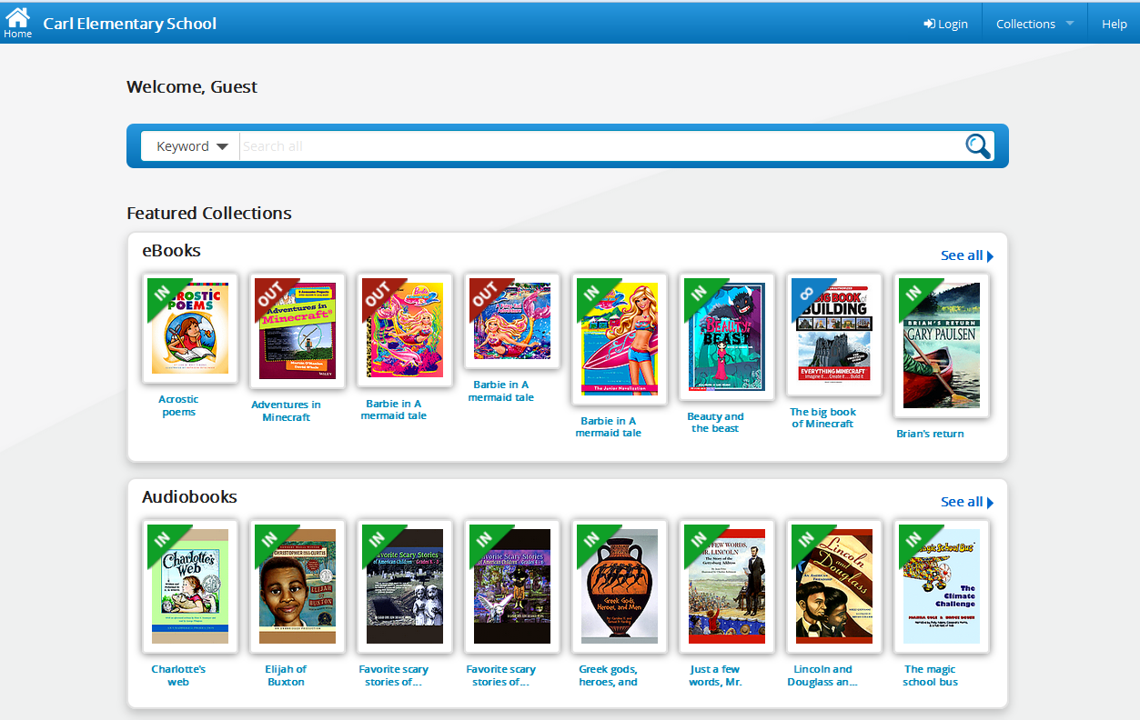
Step 3: Select Login

Slide 5
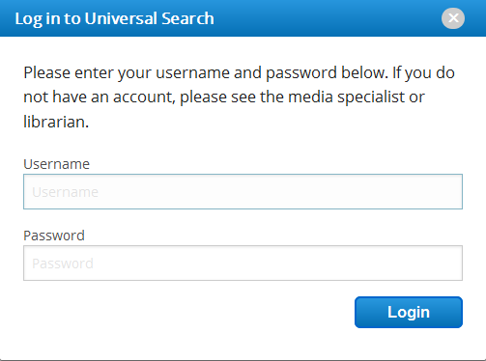
Step 4: Enter Your Info
Student Number
First Name

Slide 6
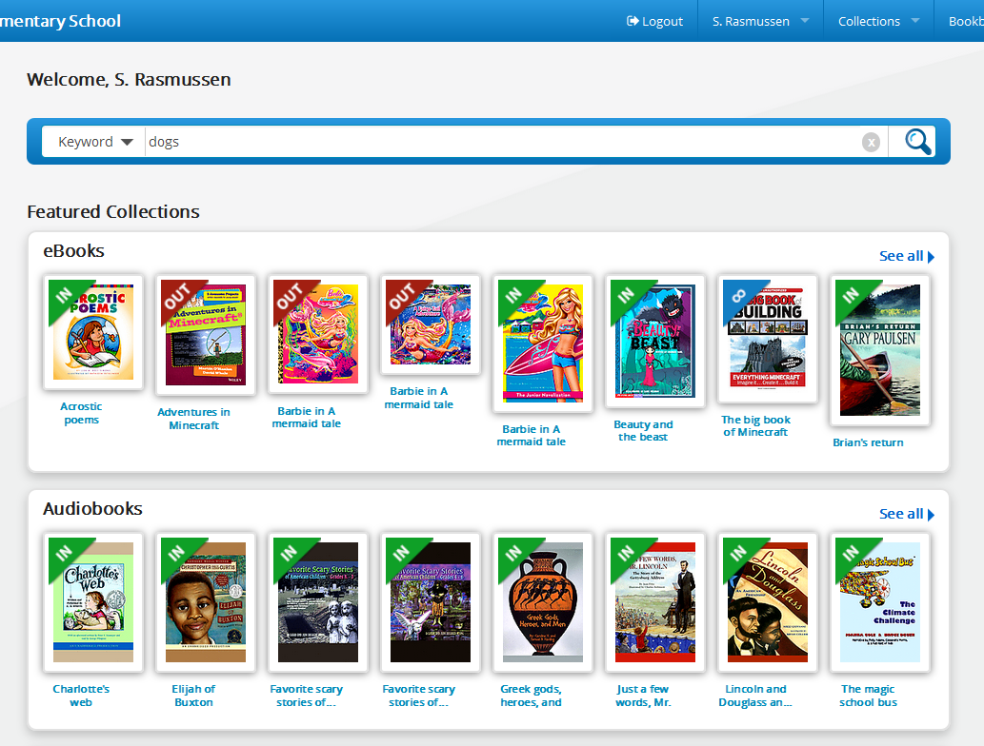
You’re In!
Search Here
. . . 0r browse for eBooks
. . . 0r browse for audiobooks

Slide 7
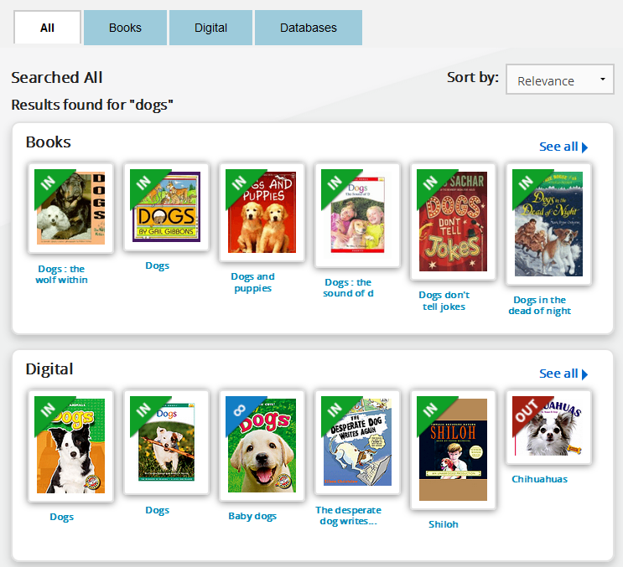
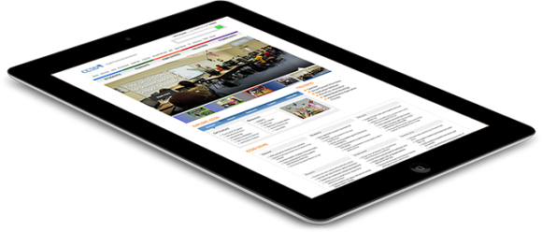
Search results show our library’s print books, eBooks and audiobooks.
‘Books’ are print library books
‘Digital’ items
are eBooks & audiobooks

Slide 8
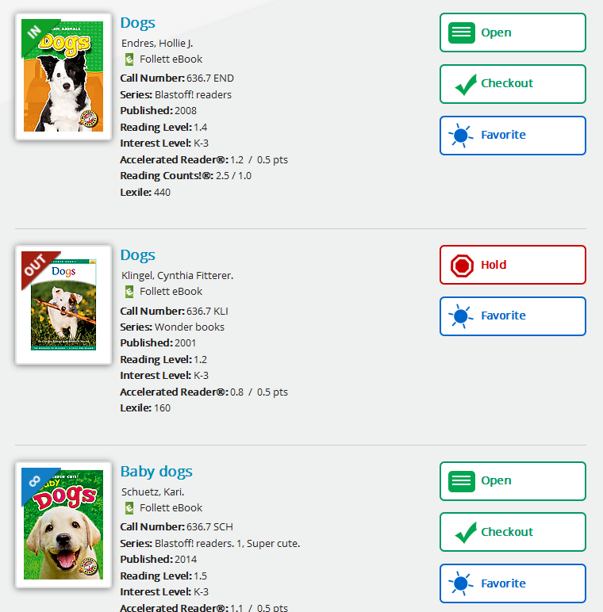
available
Sample Searches
dogs, sharks, Batman, ghosts, Judy Moody, Percy Jackson, Star Wars, Geronimo Stilton, Junie B. Jones, horror
checked out
unlimited copies

Slide 9
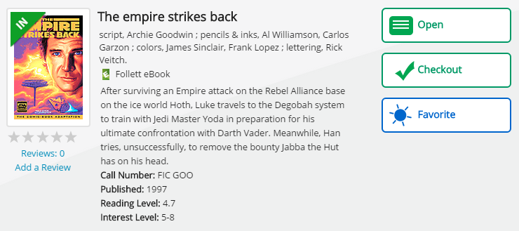
Open a book to preview it.
Borrow it right away.

Slide 10
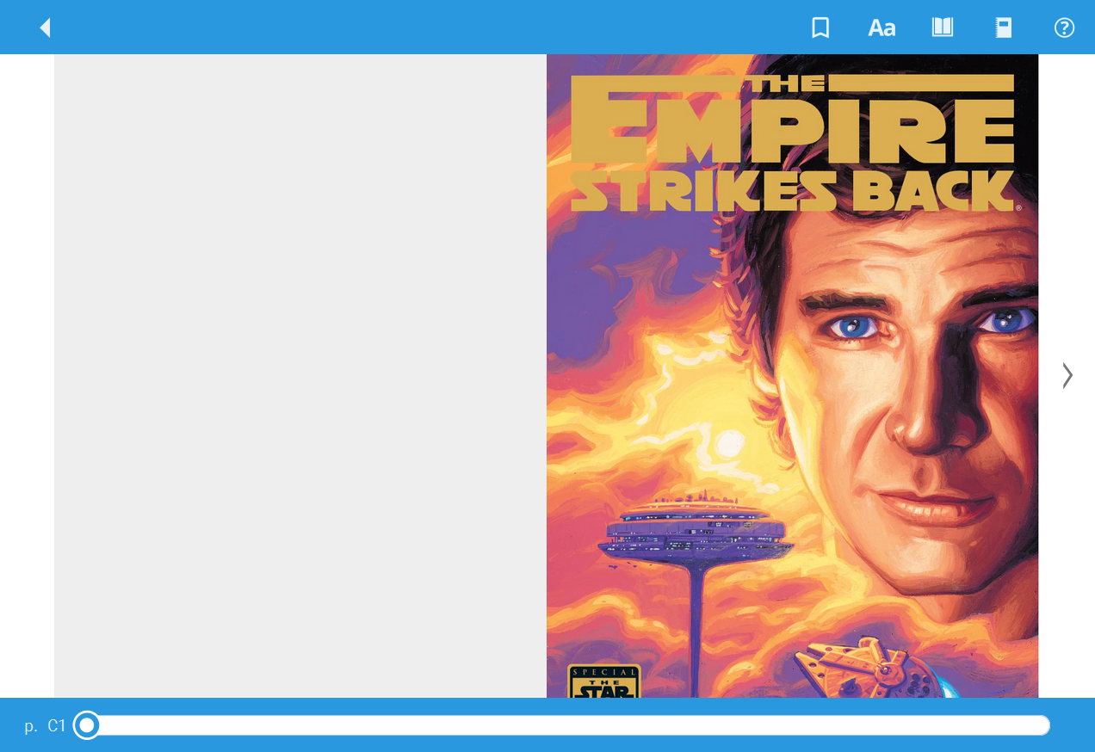
Once you open a book…
Click here to turn pages

Slide 11
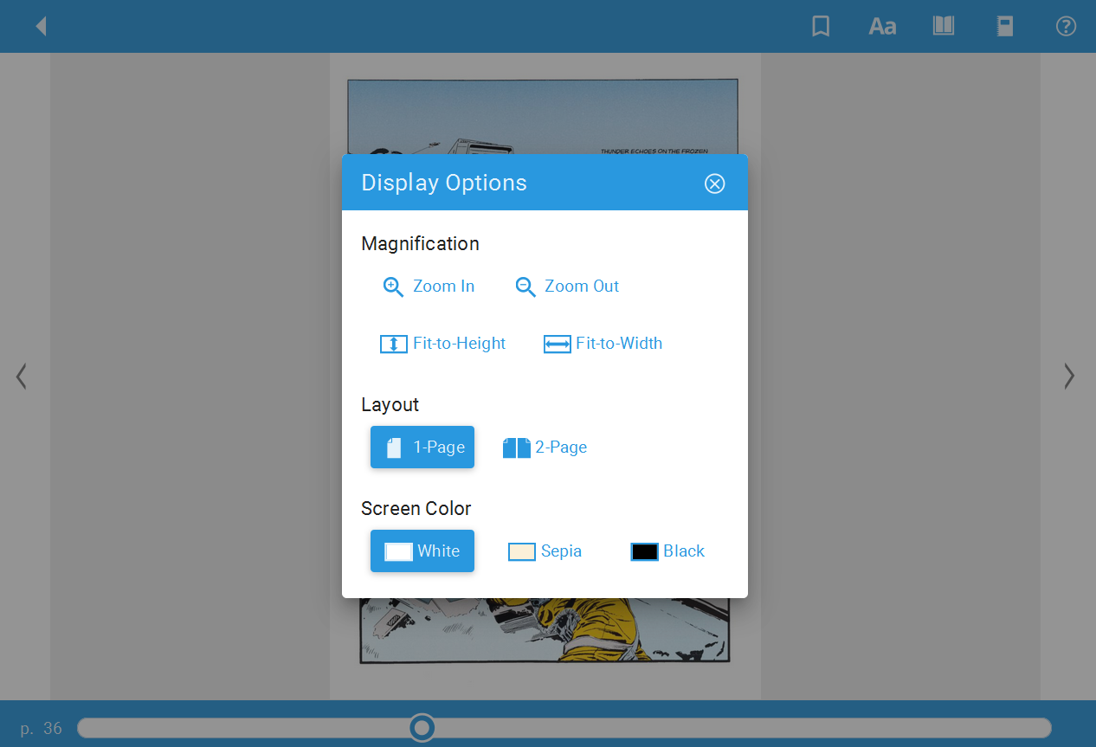
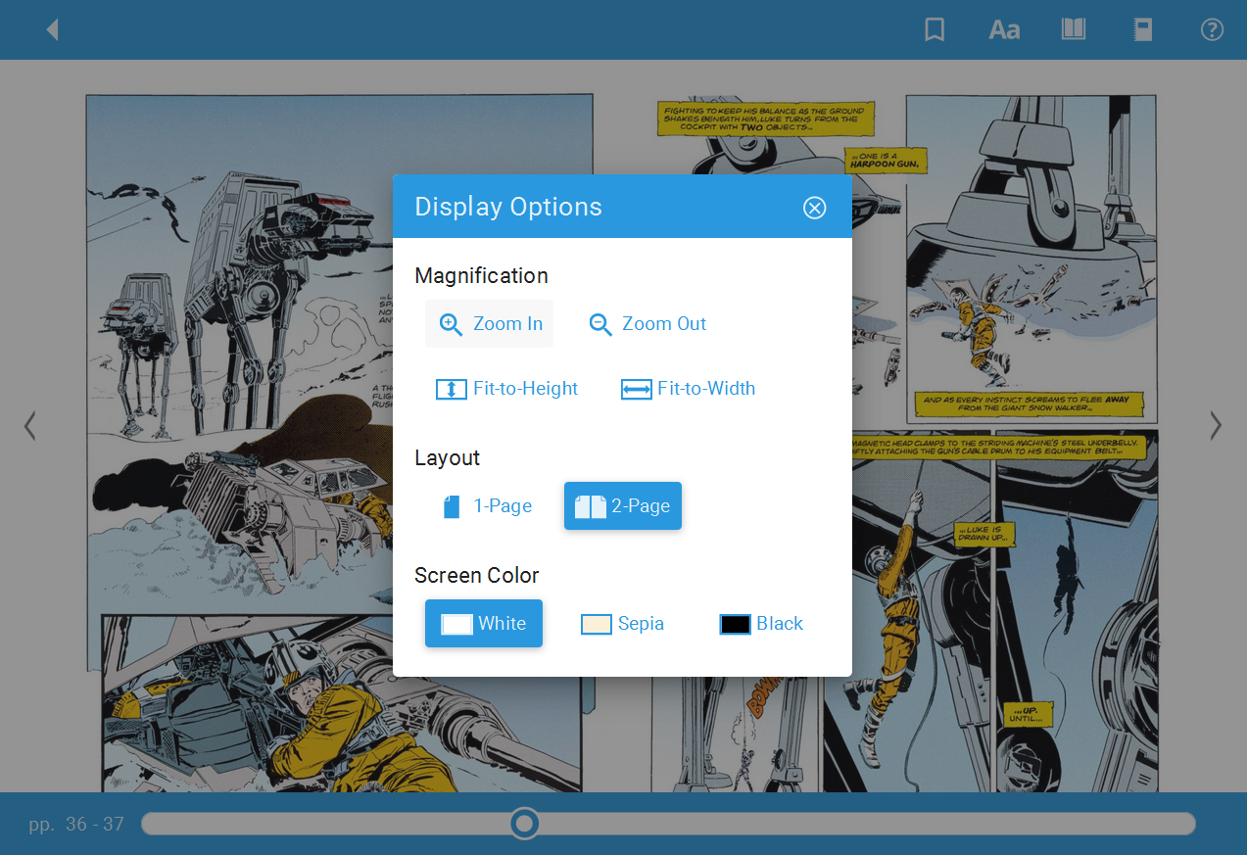
One Page View?
Or Two Page View?

Slide 12
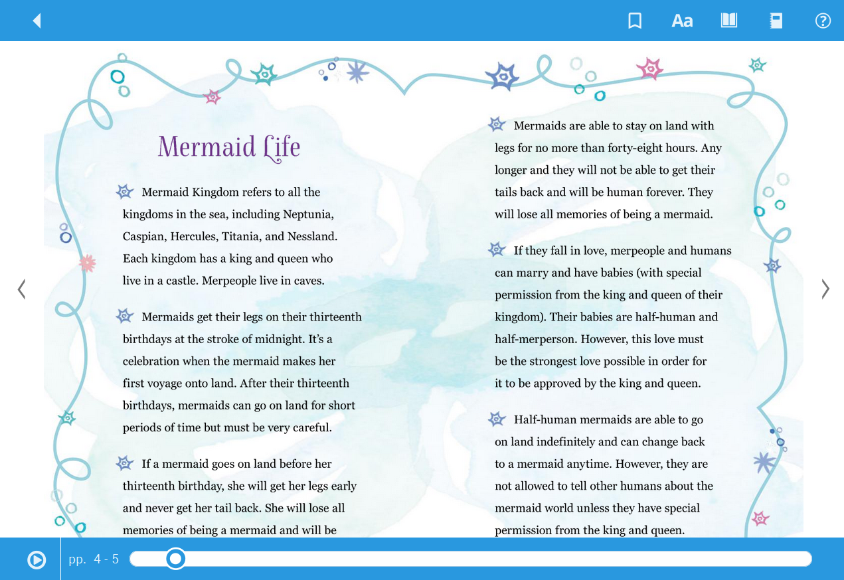
Some Books Will Read To You!
If the feature is available, click play.

Slide 13
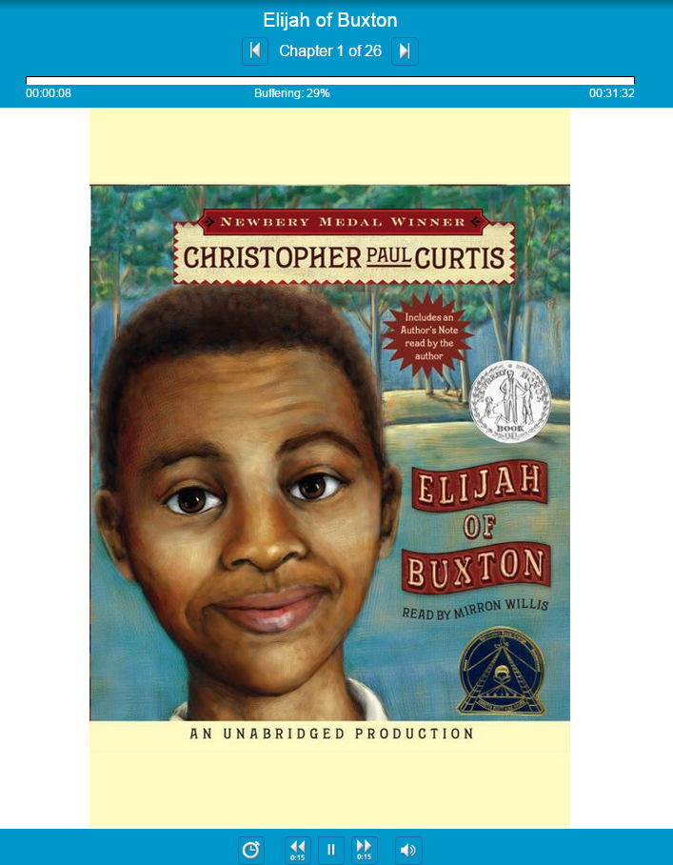
Audiobooks
Audiobooks let you listen to great books.

Slide 14
Bookbag
Go to Bookbag to
see what you have checked out.

Slide 15
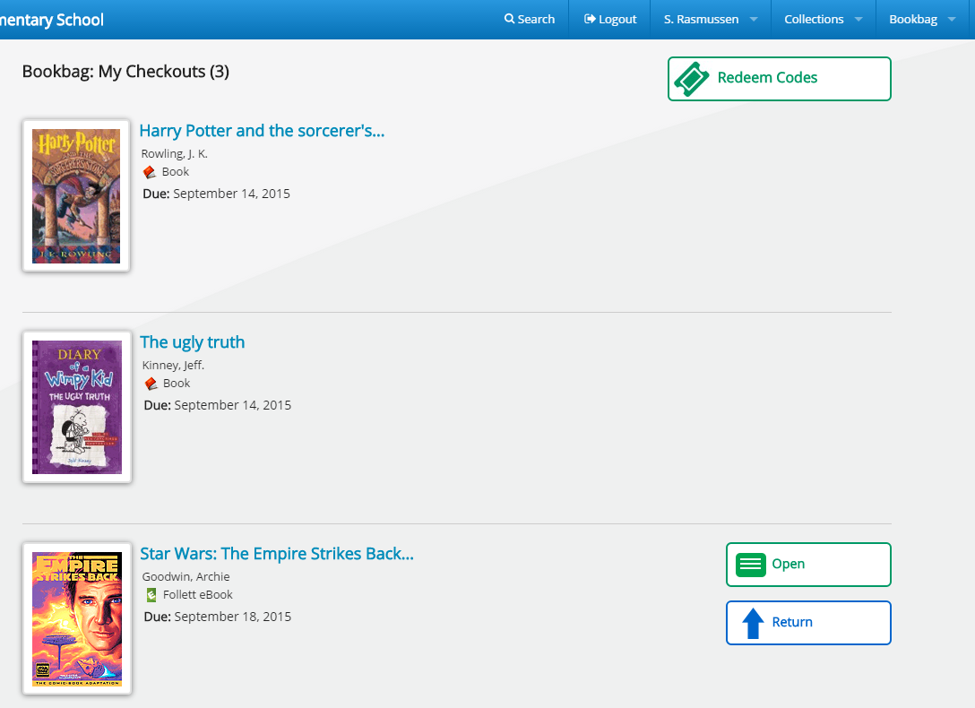
Bookbag
These are the print books that you have checked out of the library. Return them on library day.
Once in Bookbag, click Open to read the eBook on a computer, smart phone, tablet or E-reader.
This is an eBook. It will automatically return in seven days.

Slide 16
Bookbag
If you’re done with an eBook, return it early so that others can also enjoy it.

Slide 17
The Follett Destiny Discover App
You can simply use Destiny Discover through a web browser, but if you’re going to read often, you’ll want to download and install the Follett Destiny Discover app. It offers additional features.
The free app can be found at the Apple App Store or Google Play Store.
The free app can be found at the Apple Store or Google Play Store. For a master page of all BryteWave app sites, visit the below link.
http://www.follettlearning.com/books-materials/learn/digital-content/follett-ebooks/ebook-management/destiny-discover/download
For activation, our shelf code is wbb22514.
All apps

Slide 18
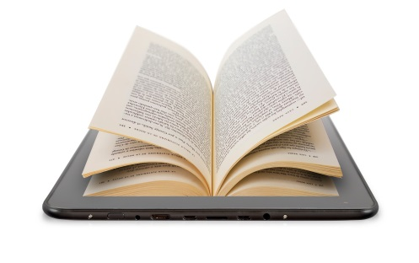
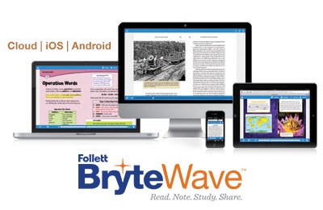
Benefits of eBooks
Our eBooks will read to you
Available 24 hours a day, 365 days a year
These are in addition to the two print books that students already borrow during library class
They cannot be lost, stolen, or damaged
Audiobooks let you listen to great stories
They can never be late
They’re free for you to use!

Slide 19
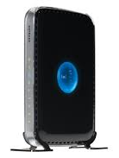
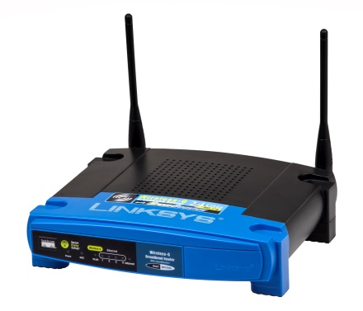
Connecting Your Device Outside of School
You’ll need WiFi to at least initially connect your device. Through BryteWave, you will then be able to download your eBooks and read them at any time.
If you don’t currently have WiFi at home, these ISPs offer discounted Internet rates to CCSD families in need.
http://ccsd.net/district/mobile-device-initiatives/pdf/home-internet-access.pdf
As part of the Mobile Device Initiative (MDI), local businesses offer free WiFi hotspots to CCSD students. Visit the MDI web site for locations.
http://ccsd.net/district/mobile-device-initiatives

Slide 20
Connecting Your Device at School
Connect
to the school’s WiFi
0279-WiFi password: See Mr. Dwyer
manual/advanced server information:
proxy.ccsd.net
port 80
Login using the BryteWave app
Username: student #
Password: first name
Shelf url: wbb22514

Slide 21
Links
The Kay Carl eBook Portal
http://schools.ccsd.net/carl/librarymediaprogramebook.html
Is your device compatible?
http://www.aboutfollettebooks.com/techspecs.cfm
Internet Service Providers that offer discounts
http://ccsd.net/district/mobile-device-initiatives/pdf/home-internet-access.pdf
Mobile Device Initiative WiFi hotspots
http://ccsd.net/district/mobile-device-initiatives

Slide 22
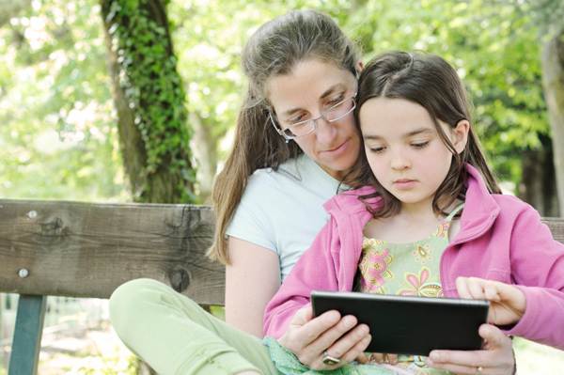
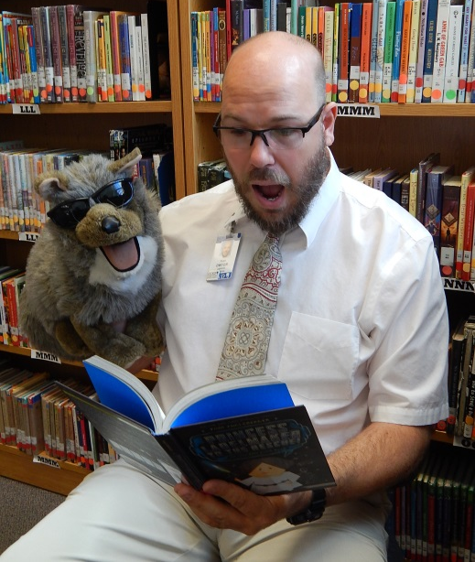
Kay Carl’s eBooks
Enjoy Kay Carl’s eBooks and Audiobooks!
If you have any problems, contact Book Master Dwyer

